Slide 1
USER AND VEHICLE
DATA MANAGEMENT
Abinaya V - 33106

Slide 2
AGENDA
Project Overview
User Profile Microservice
Vehicle Discovery Microservice
Interconnection and Integration
Implementation Details
API Endpoints
Database Configuration
High Level Flow Chart Diagram
Technologies Used
Demo
Conclusion

Slide 3
Project Overview
Development of two microservices using the Spring Boot framework.
User Profile - Microservice 1:
Description: This microservice is responsible for handling user and vehicle related operations and stores in a MySQL database.
Responsibilities:
Store user and vehicle information in MySQL.
Provide endpoints to create users and vehicle for retrieving their information.
Fetch vehicle information based on user mobile number.
Vehicle Discovery - Microservice 2:
Description: This microservice fetches vehicle information from UserProfile (Microservice 1) based on user mobile number and stores it in MongoDB.
Responsibilities:
Fetch vehicle information from UserProfile (Microservice 1) connected with MySQL.
Store the fetched vehicle information in MongoDB.

Slide 4
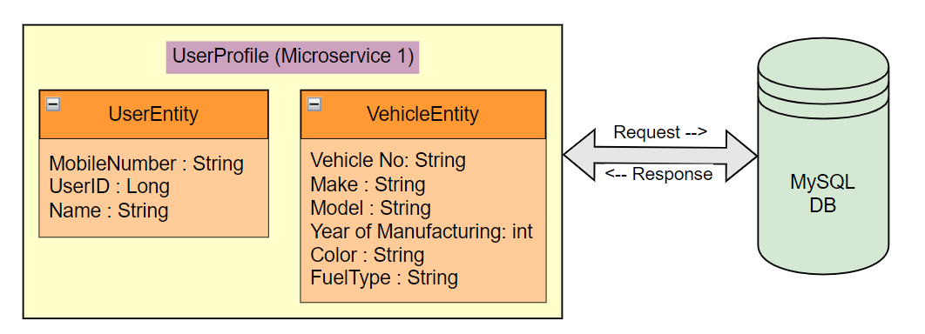
User Profile Service (Microservice 1)
The User Profile (Microservice 1) is a component of the larger system designed to manage user and vehicle information.
It serves as a backend service responsible for handling CRUD operations on users and vehicles, storing the data in a MySQL database.

Slide 5
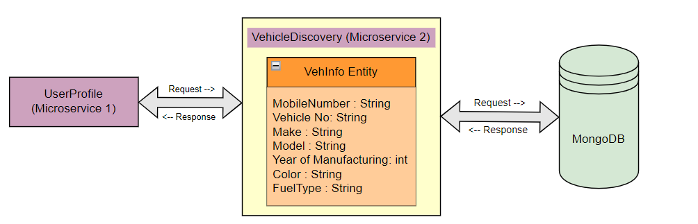
Vehicle Discovery Service (Microservice 2)
Microservice 2 (Vehicle discovery) requires access to vehicle information stored in UserProfile (Microservice 1’s) MySQL database.
Then, Microservice 2 initiates requests to Microservice 1, providing the mobile number associated with each vehicle.
Microservice 1 processes these requests, retrieves the corresponding vehicle details from the MySQL database, and sends the data back to Microservice 2.
Upon receiving the vehicle information, Microservice 2 stores it in its MongoDB database, including the associated mobile number.

Slide 6
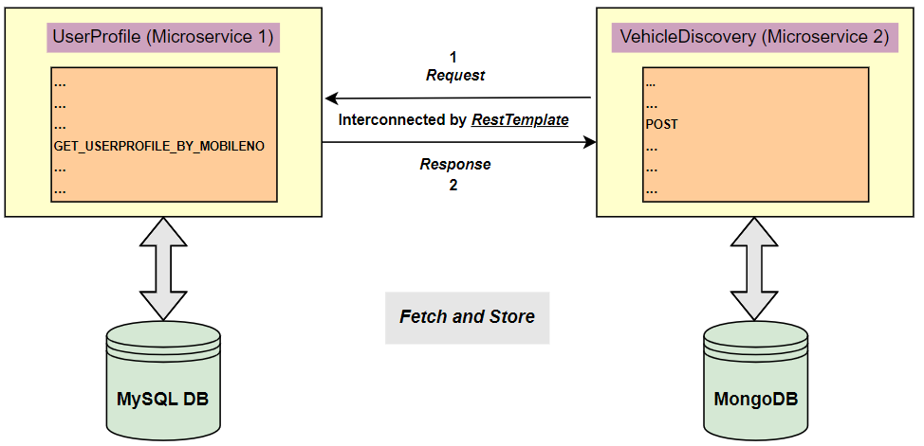
Interconnection and Integration
Interconnection:
The User profile (Microservice 1) and the Vehicle discovery (Microservice 2) are both connected to MySQL databases for storing data. Microservice 2 additionally utilizes a MongoDB database for its operations.
Integration:
To fulfil the requirement of fetching vehicle information from UserProfile (Microservice 1) and storing it in VehicleDiscovery (Microservice 2’s) MongoDB database.
Microservice 2 fetches vehicle details from Microservice 1 using the mobile number associated with each vehicle.
Upon Fetching, Microservice 2 saves the fetched vehicle data along with the corresponding mobile number in its MongoDB database.

Slide 7
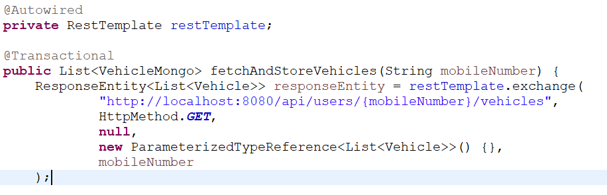
Implementation Details
API Endpoints:
API endpoints serve as the interface for communication between microservices and external systems, enabling the functionality of the application.

Slide 8
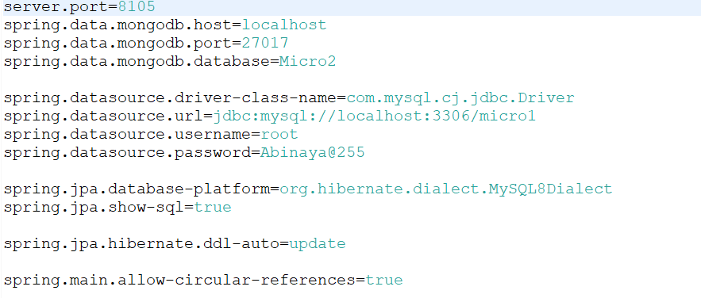
DATABASE CONFIGURATION:

Slide 9
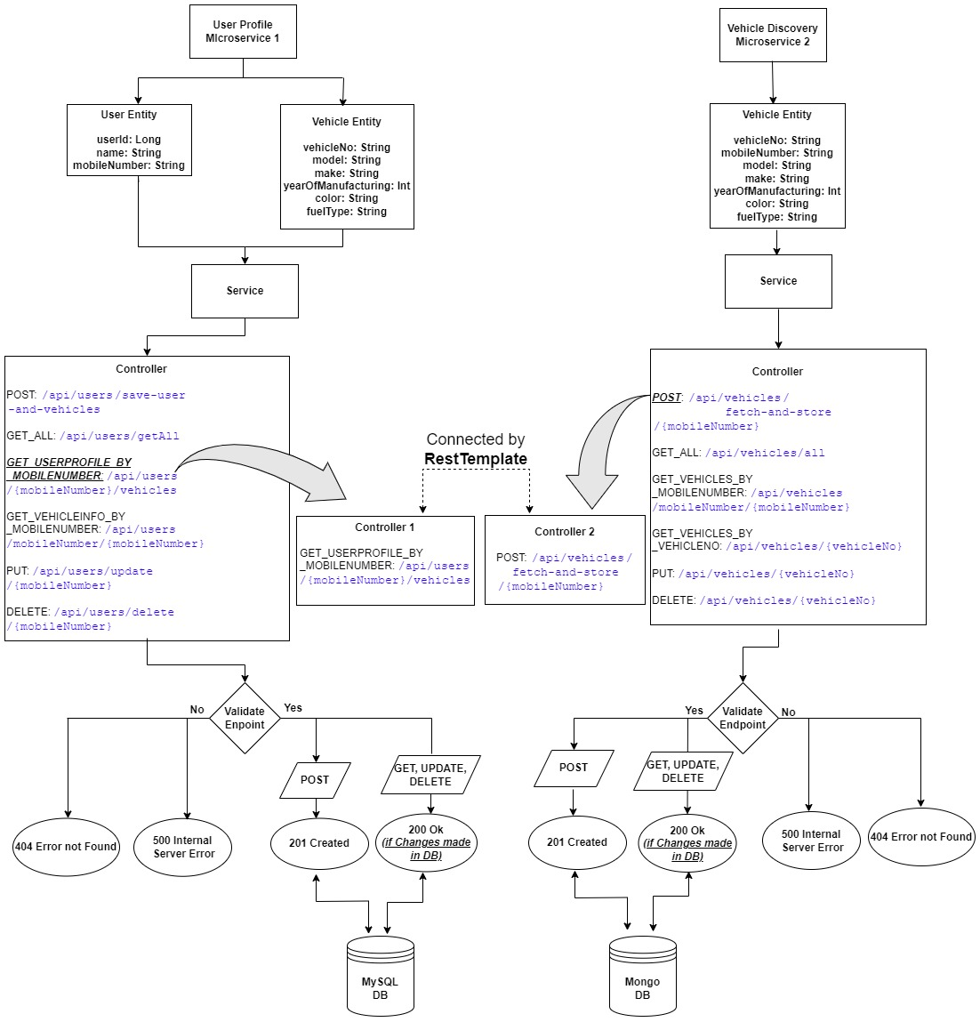
HIGH LEVEL FLOW CHART DIAGRAM

Slide 10
Technologies Used
Spring Boot: A popular Java framework for building microservices.
Version: 2.5.4
MySQL: A relational database management system used for storing user information.
Version: 8.0.26
MongoDB: A NoSQL database used for storing vehicle information.
Version: 2.5.4
Java Development Kit
Version: 11 or higher
Apache Maven:
Version: 3.8.2

Slide 11
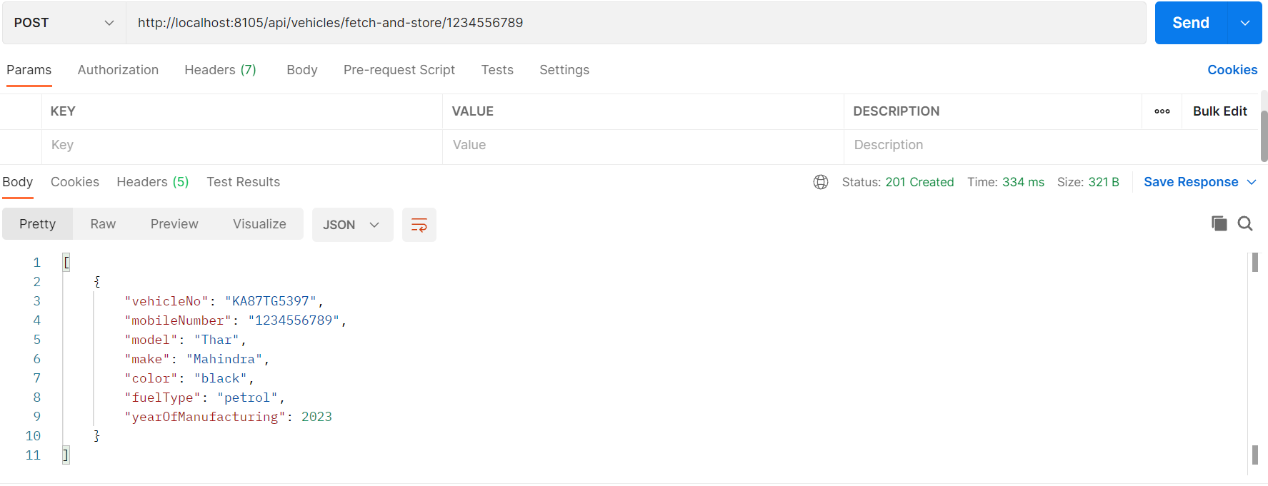
DEMO
Sample Output for fetching and storing vehicle data

Slide 12
CONCLUSION
The integration of Microservice 1 and Microservice 2 enables efficient management of user and vehicle information across the system.
MySQL and MongoDB provides flexibility and scalability for handling diverse data requirements.
By following best practices in microservices architecture and database management, the system can adapt to evolving business needs and ensure robustness in data handling and processing.

